Slide 1

Preliminary Change of Ownership Report
BOE-502-A

Slide 2
What is a PCOR?
Law presumes a grant of title is a change in ownership
Change in ownership = reassessment to current market value
Presumption: Purchase price = market value
PCOR provides information to Assessor:
Change in Ownership exclusions (Part 1)
Assessment information (Parts 2-4)

Slide 3
BOE-502-A Rev. 12 (11-12) CHANGES
Mailing Address
PART 1. TRANSFER INFORMATION
PART 3. PURCHASE PRICE AND TERMS OF
SALE
PART 4. PROPERTY INFORMATION
Additional Information

Slide 4
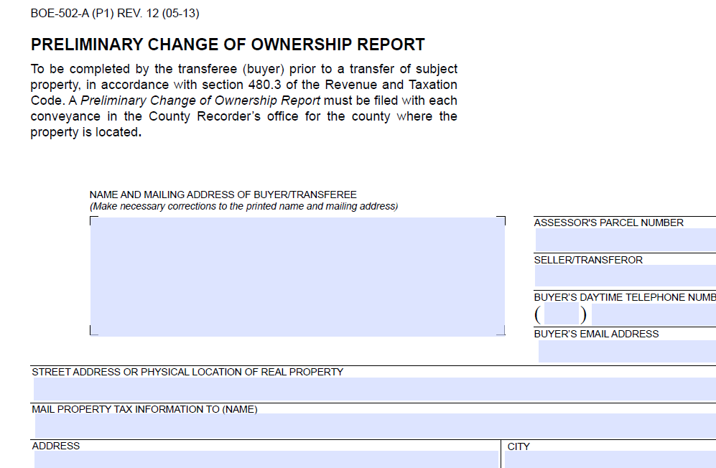
Mailing Address
For assessor use only
Problem:
Mailing addresses must match

Slide 5
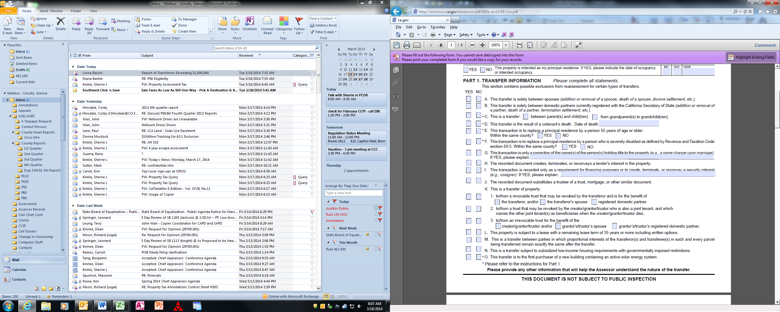
Part 1, Question C:
Parent-child exclusion (P58):
2-way exclusion
Parent to child
Child to parent
Grandparent-grandchild exclusion (P193): One-way exclusion
Grandparent to grandchild only

Slide 6
Part 1, Question D
New cotenancy change in ownership exclusion
Effective January 1, 2013
2 owners – tenancy in common or joint tenants
Applies to date of death of one cotenant
For 1 year prior to date of death:
Both cotenants must be owners of record
Property must be primary residence of both cotenants
Surviving cotenant must inherit property
Surviving cotenant must file affidavit with assessor
Letter To Assessors 2013/021

Slide 7
Part 1: Questions C, D, E, F, O
Asterisk (*)
A claim form must be filed with assessor
Forms available from assessor

Slide 8
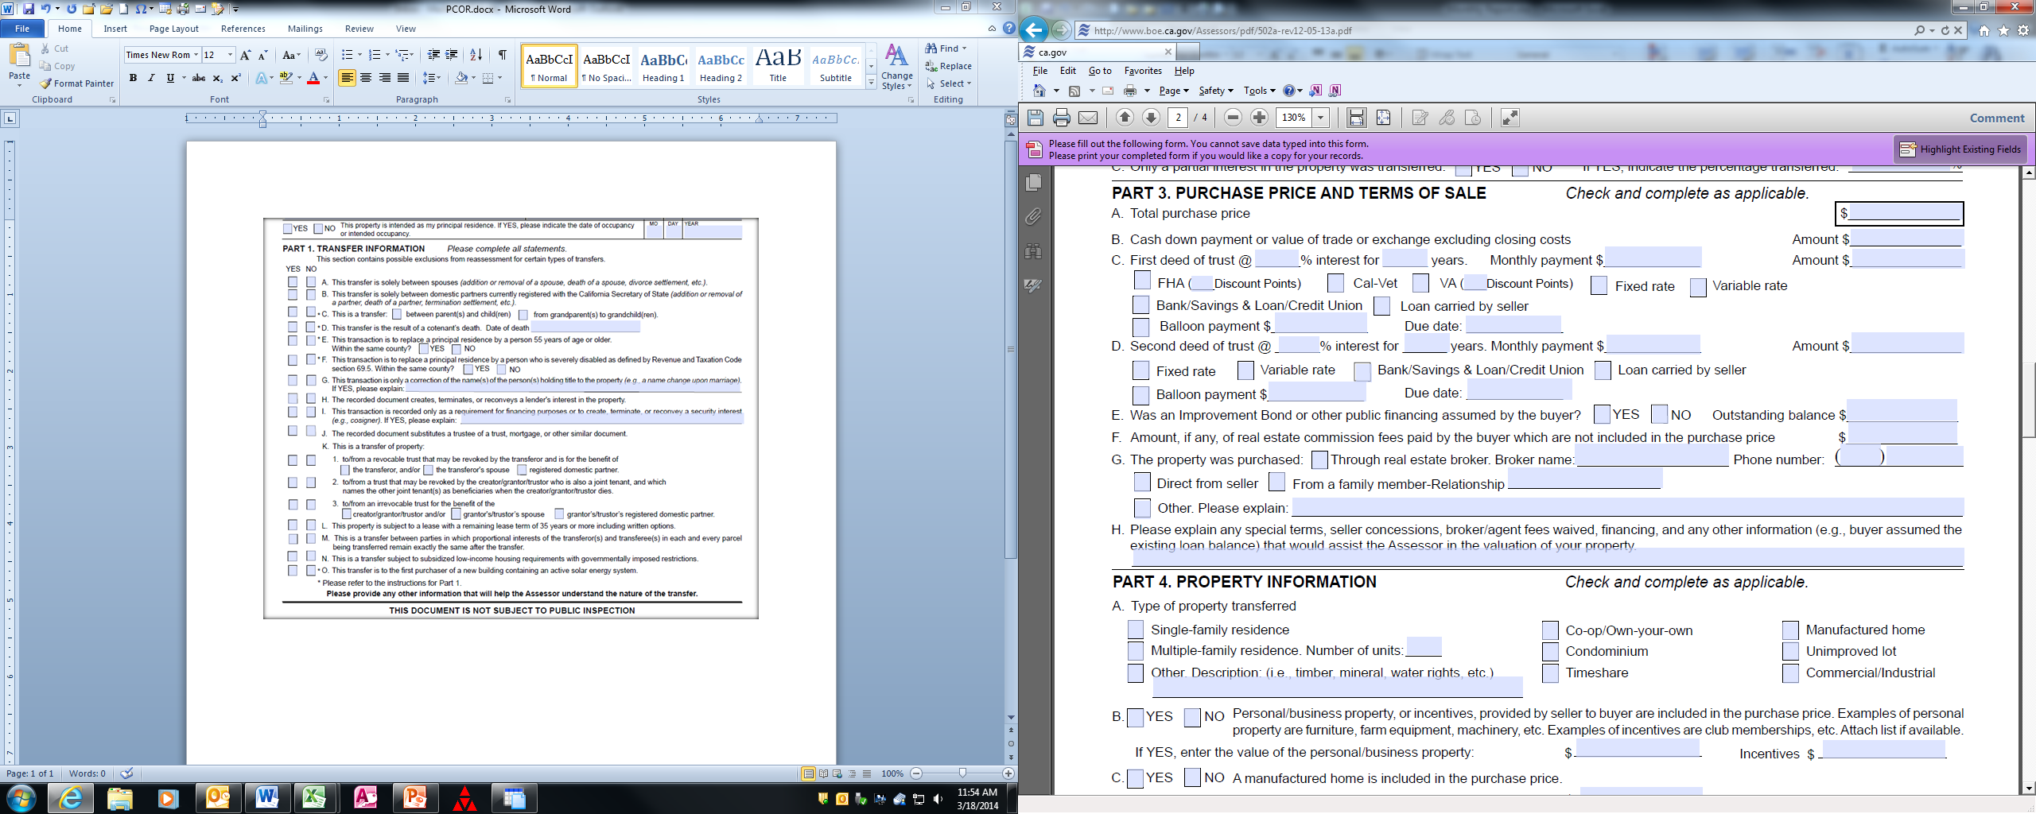
Part 3, Purchase Price and Terms of Sale
Helps assessor determine market value
If not completed, assessor will request another PCOR or a Change in Ownership Statement (penalty if not returned within 90 days)

Slide 9
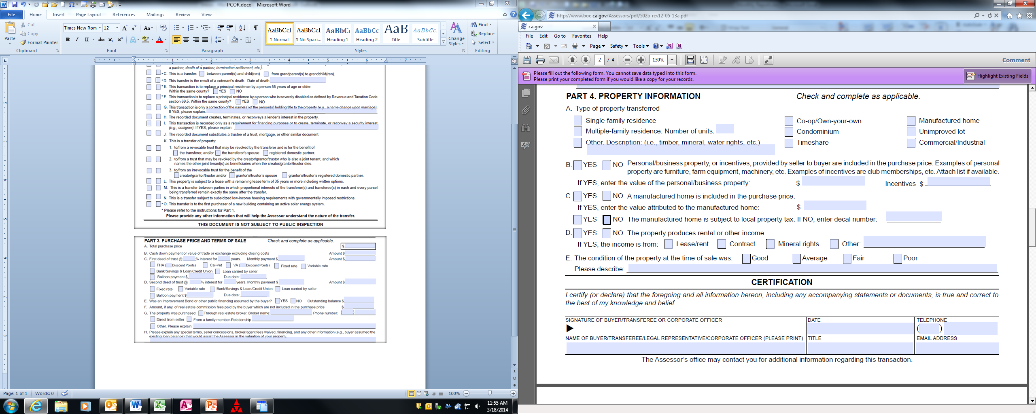
Part 4, Property Information
Helps determine market value
Value of personal property items deducted - not included in determination of base year value

Slide 10
Additional Information
PCOR’s filed for transactions other than sales
Assessor may send PCOR instead of COS
Helpful information for those not using an escrow company!

Slide 11
What is the difference between a PCOR and a COS?
Preliminary Change of Ownership Report
Provided to county recorder when document evidencing a change in ownership is recorded
Change in Ownership Statement
Filed with assessor whenever a change in ownership occurs
Unrecorded contract of sale
Date of death –
Probate - When inventory and appraisal is filed
Other – 150 days after date of death

Slide 12
Are there any penalties?
Preliminary Change of Ownership Report
Penalty: $20 recording fee if not provided
Change in Ownership Statement
Penalty: No penalty unless assessor makes request
Upon request, must file within 90 days
Penalty: Greater of:
(A) $100
(B) 10% of taxes on new base year value, not to exceed $5,000 (HOX) or $20,000 (no HOX)

Slide 13
Can a PCOR be filed electronically?
Yes
Some counties now accept electronic filing

Slide 14
Does a PCOR require an original signature?
No
A COS requires an original signature, but not a PCOR.

Slide 15
Why was the joint tenancy question deleted a couple years ago?
Industry requested the change.
The determination of original transferor status is a factual determination made from deeds recorded. No request or additional forms need be filed.

Slide 16
How do forms get changed?
Coordinated effort:
BOE
California Assessors’ Association, Forms Subcommittee
Interested parties meeting
Forms Subcommittee and BOE meet annually

Slide 17
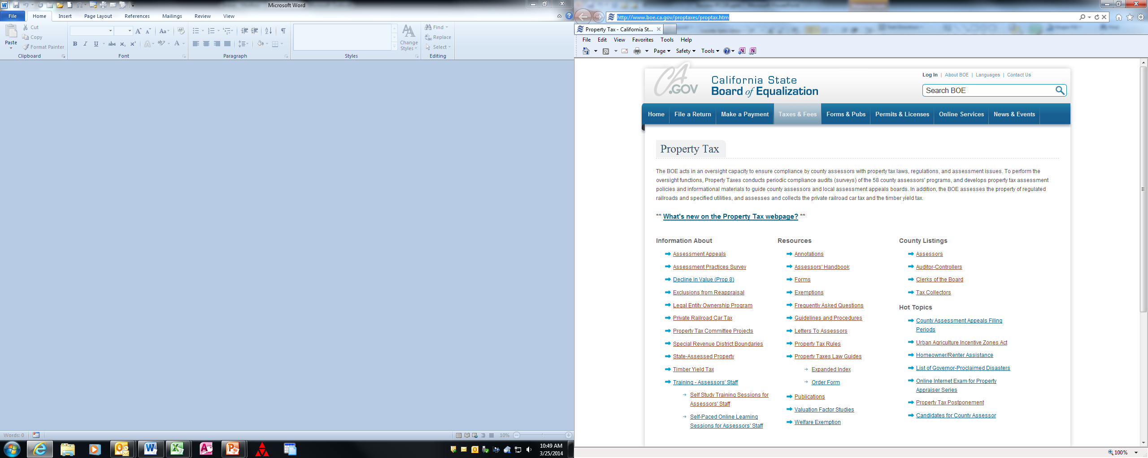
Where can I find information?
www.boe.ca.gov/proptaxes/proptax.htm

Slide 18
What is a supplemental assessment?
Difference between old value and new value, prorated for remainder of fiscal year
June 1 – December 31
One supplemental assessment
January 1 – May 31
Two supplemental assessments
Current fiscal year
Roll being prepared

Slide 19
Legal Entities
Transfer of real property between legal entities
File PCOR when deed is recorded
Transfer of interest in a legal entity
File BOE-100-B, Statement of Change in Control and Ownership of Legal Entities, with BOE
Change in control – acquisition of more than 50%
Change in ownership – more than 50% of original co-owner interests transfer
See BOE website: www.boe.ca.gov/proptaxes/leop.htm

Slide 20
Role of BOE
Property Tax Oversight
Advisory agency on PT assessment matters
Survey county procedures
Appraiser Training & Certification
Co-administration of Welfare Exemption
Assessment of Railroads & Public Utilities
Collection of :
Private Railroad Car Tax
Timber Tax
Sales and Use Tax
30 Special Taxes & Fees

Slide 21
Questions?
Give us a call!
Board of Equalization
County-Assessed Properties Division
1-916-274-3350

